Slide 1

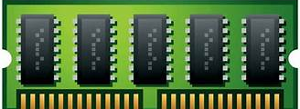

Heap Memory Manger
Advanced system programming under Linux training
@STMicroelectronics
Under supervision: Eng. Reda Maher
Omar Elshamy

Slide 2
Outline
1. Intro to Heap Memory Manger
2. Design of HMM
3. Flowchart & Implementation
4. Testing
5. Make file

Slide 3
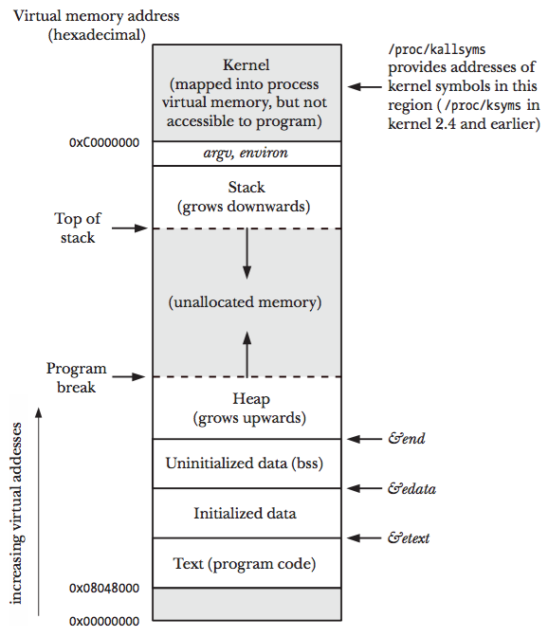
1- Heap Memory Manger
Heap: are memory area allocated to each program. Memory allocated to heap can be dynamically allocated, unlike memory allocated to stacks.
Memory layout consists of:
Text (read-only, sharable).
Data.
BSS (Block Started by Symbol).
Stack.
Heap (Program Break)

Slide 4

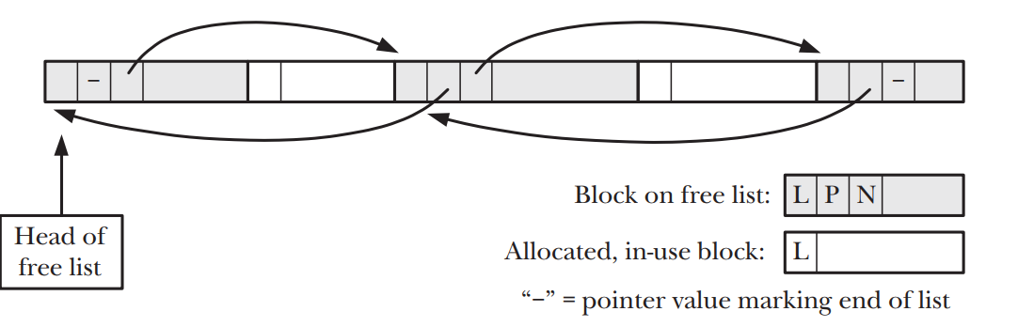
Heap Memory Manger:
A heap memory manager is a component of a computer's operating system or programming language runtime that is responsible for dynamically allocating and de-allocating memory on the heap.
When a program requests memory from the heap, the memory manager finds a suitable block of memory and reserves it for the program's use. The memory manager also ensures that different memory allocations do not overlap and cause conflicts by linking all data allocated and save an information about this data into table to can mange it.

Slide 5



HMM Vision
Program Break
List
Sbrk function.
Doubly liked list.
It is a challenge that executes a sequence of operations in according concepts of memory to perform in most of scenarios of allocating.

Slide 6

So we can say our task is :-
1- Understanding how the heap memory manger work in Linux operating system
2- How to design a software can do this task
3- How to avoid memory leaks

Slide 7

2- Design
HMM layers
HMM Abstraction layers consists of:
HMM
Doubly list
HMM
Doubly list

Slide 8
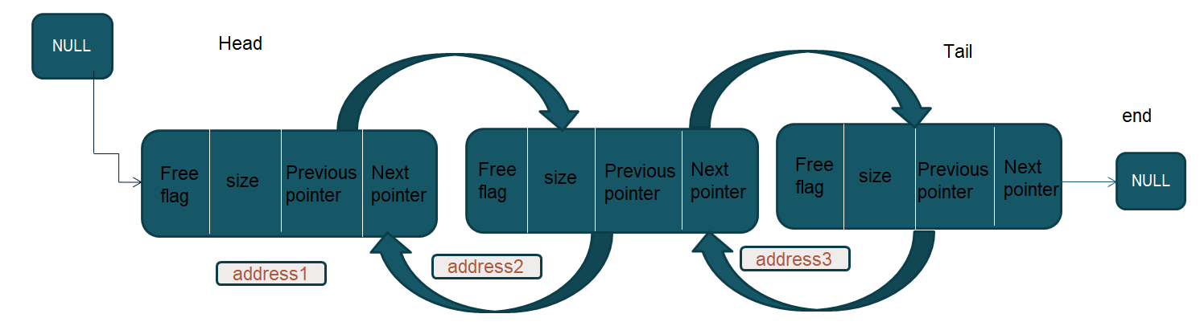
FIGURES AND STATISTICS
1. Doubly list
- This list have free and allocated nodes , each node has meta data about data allocated.
- The different between allocated node and free node is the free flag.
Node of list consists of:
Free flag: show if this node free or allocated
Size: size of data
Previous pointer: save address of previous node
Next pointer: save address of next node

Slide 9
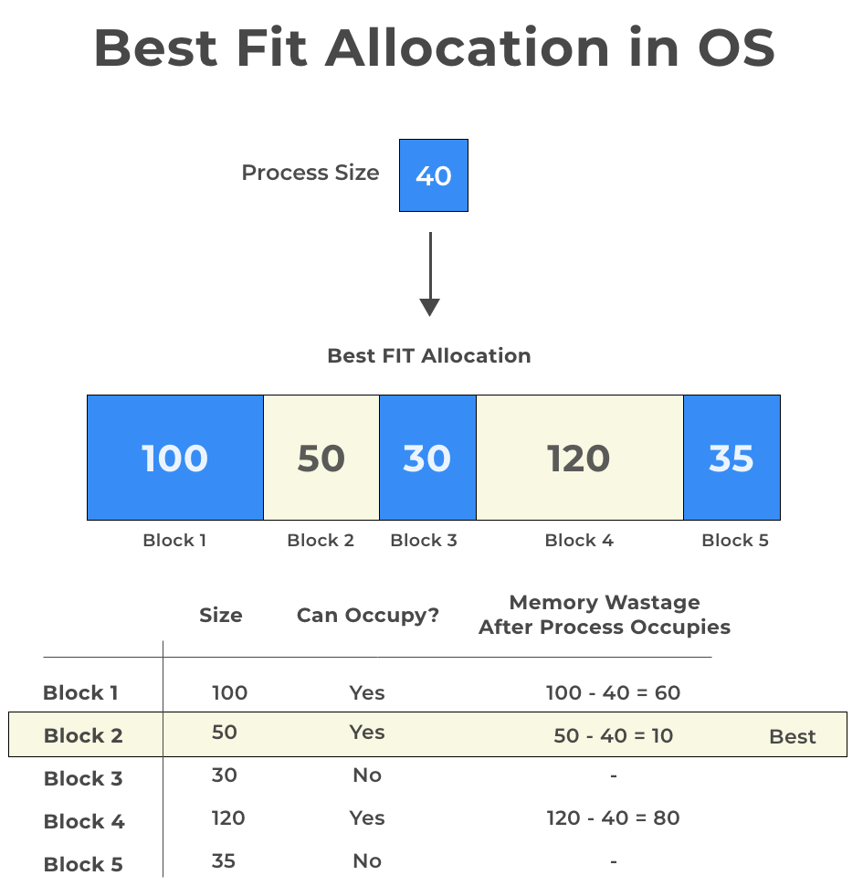
FIGURES AND STATISTICS
2. HMM
Allocating mechanism:
Alignment size to nearest multiple of bytes (8-bits).
Move the program break up with a size above the need size to allocate.
Search on best fit free node of list and split the remainder size of this node.
If there aren't free node insert new node in the tail of list.
Freeing mechanism:
Change free flag status to free.
Check if there are free node after or before free node to merge them to on free node with large size.
Move the program break down with a size less than the last free node's size.
Reallocating mechanism:
Verification of the address given It's a address of node of the list.
Check of the relation between new size and old size of this node.
If new size is bigger than old one so check on the ability to merge with next or previous node.
Last case allocate new node.

Slide 10

Memory allocating & moving program break
OUR
CYCLE
When call
Malloc
Move program break down
Move program break up
When call
free

Slide 11

3- Flowchart & Implementation
HMM consists of four function:
My malloc().
My free().
My calloc().
My realloc().

Slide 12
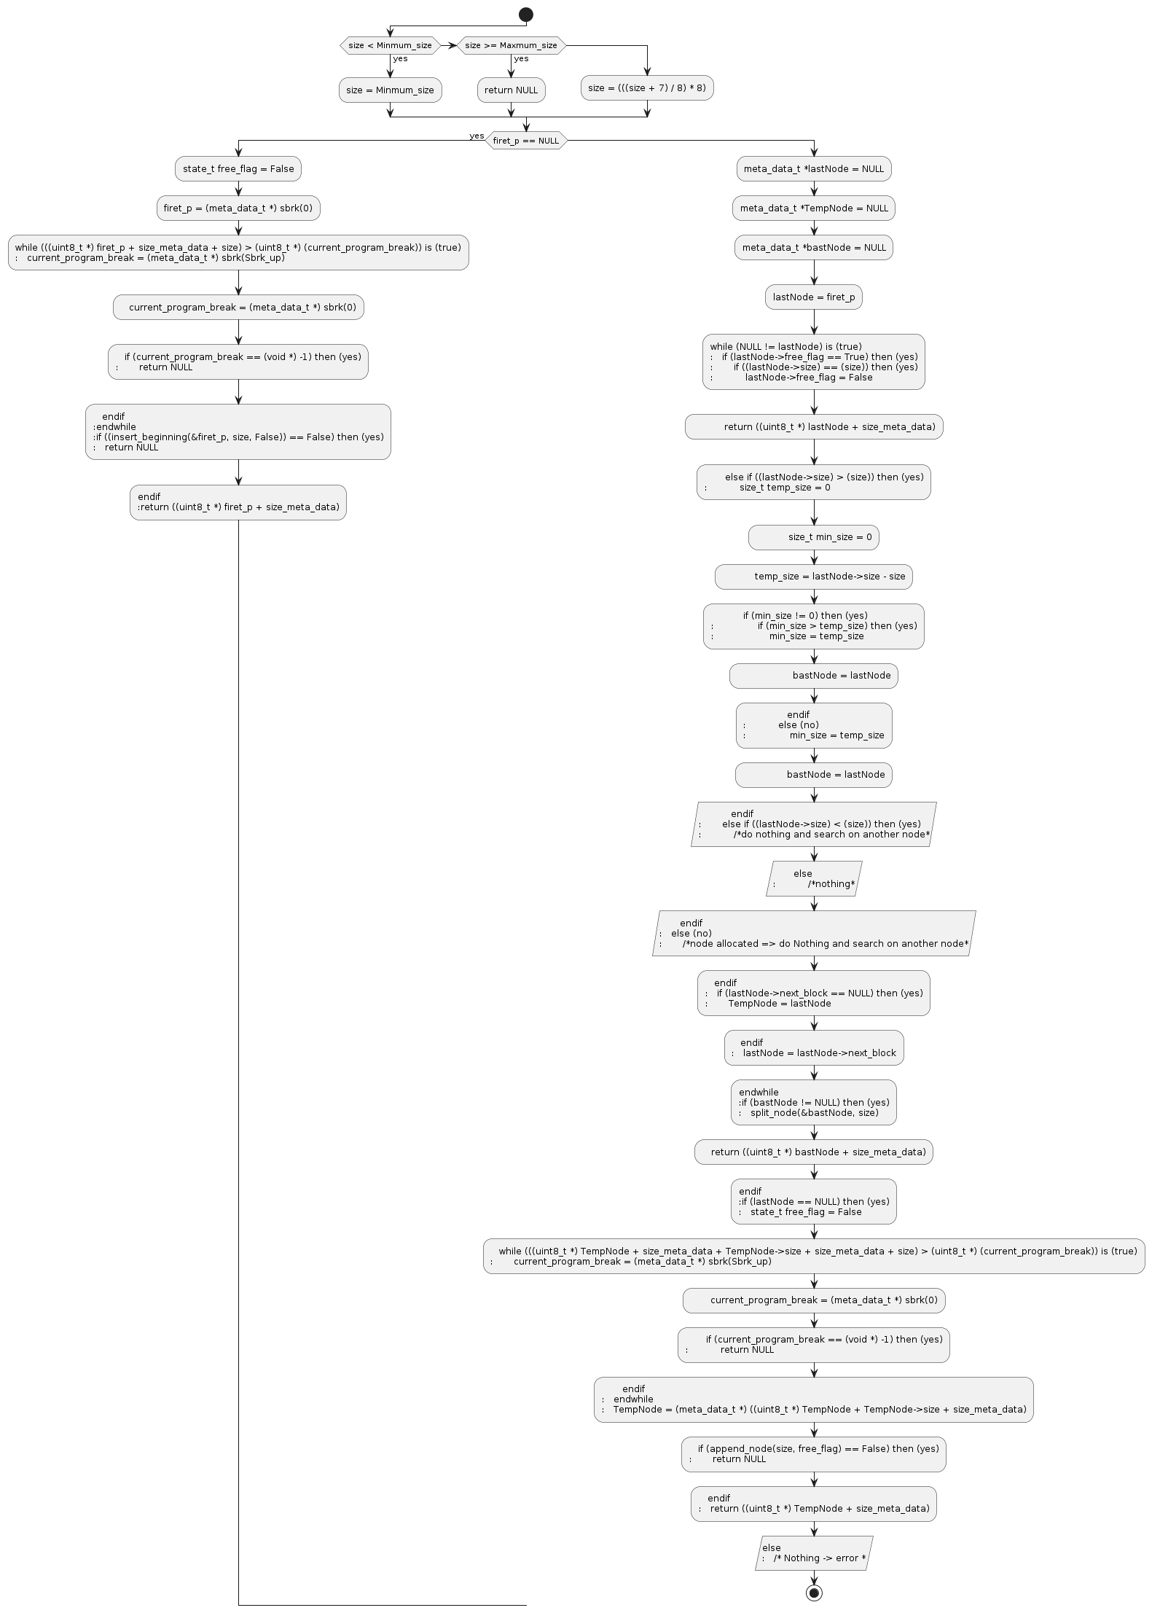
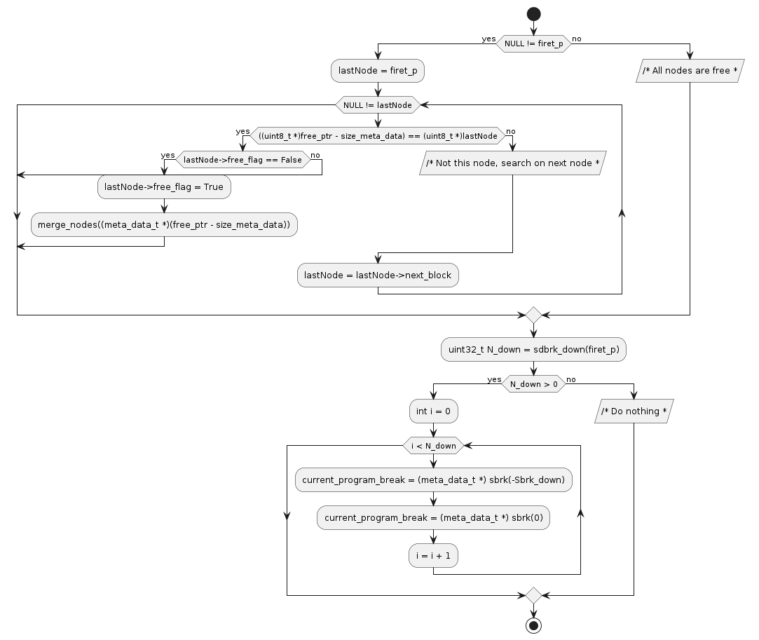
My_malloc():

Slide 13
My_free():

Slide 14
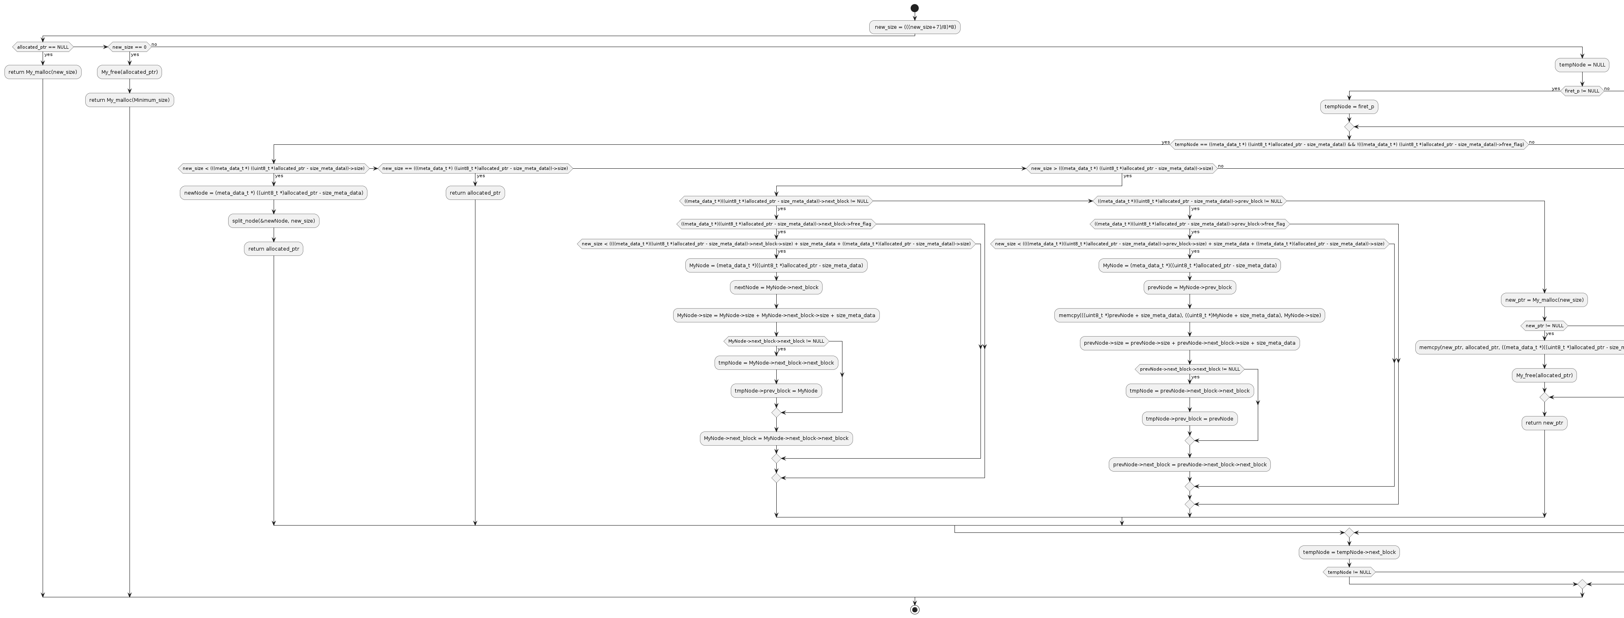
My_realloc():

Slide 15
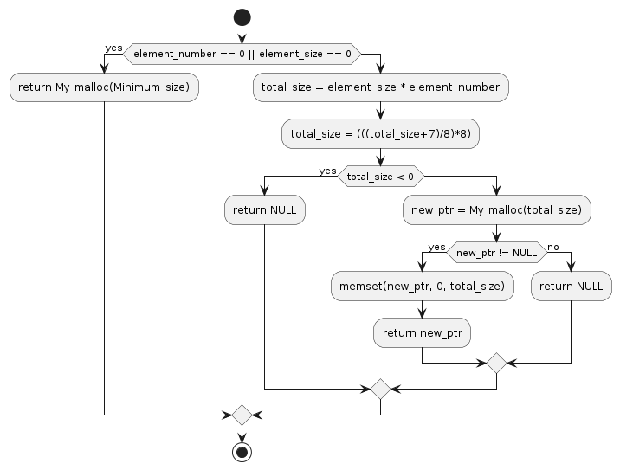
My_calloc():

Slide 16
Doubly liked list consists of four function:
Insert node().
Split node().
Merge nodes().
Sbrk down().

Slide 17
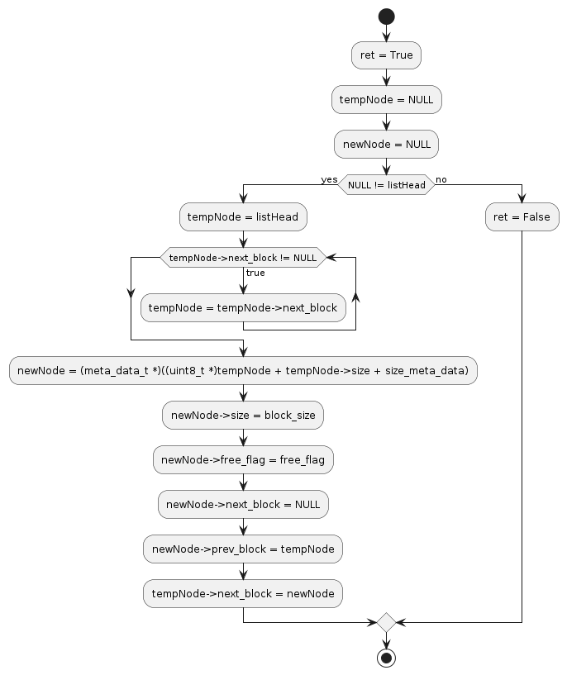
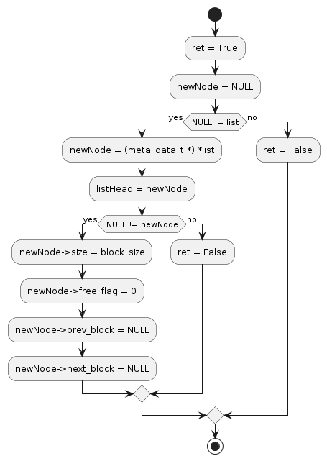
append node():
Insert beginning ():

Slide 18
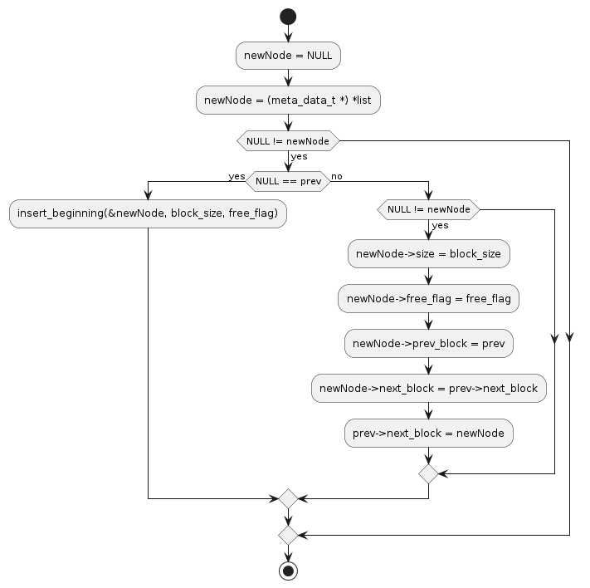
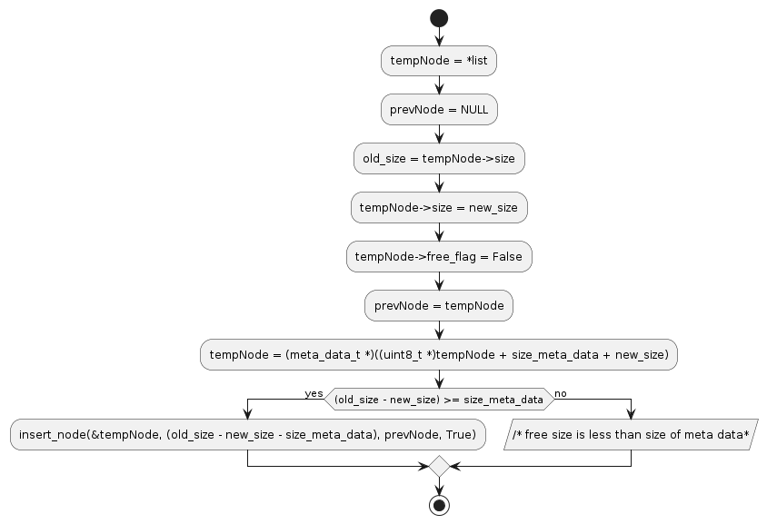
Insert node():
Split node():

Slide 19
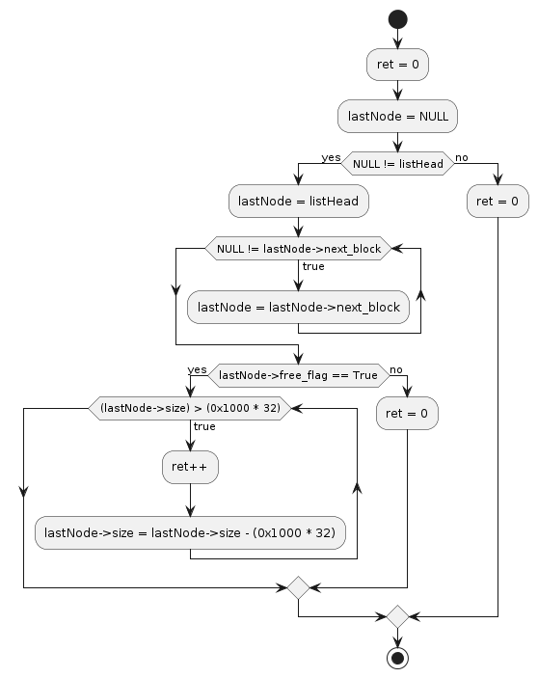
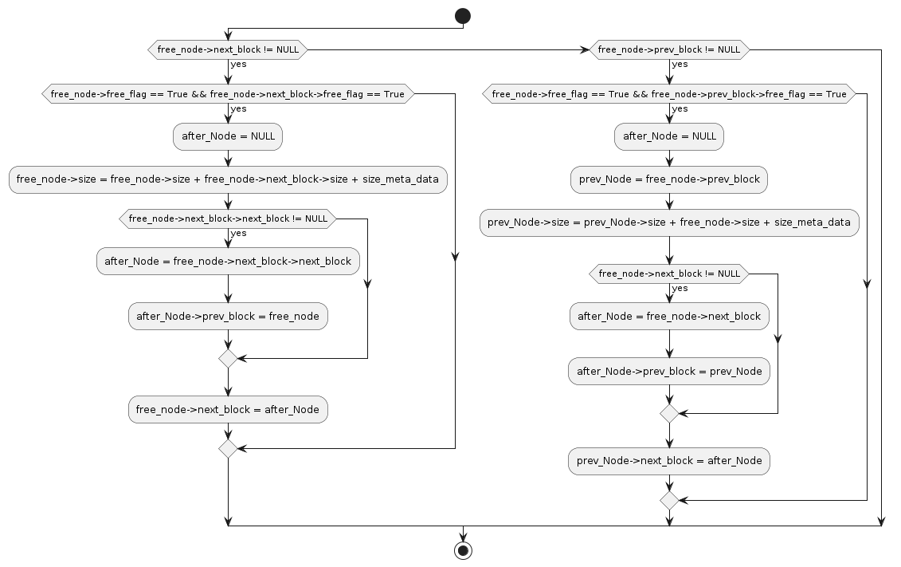
Sbrk down():
Merge nodes():

Slide 20

For source code:

Slide 21
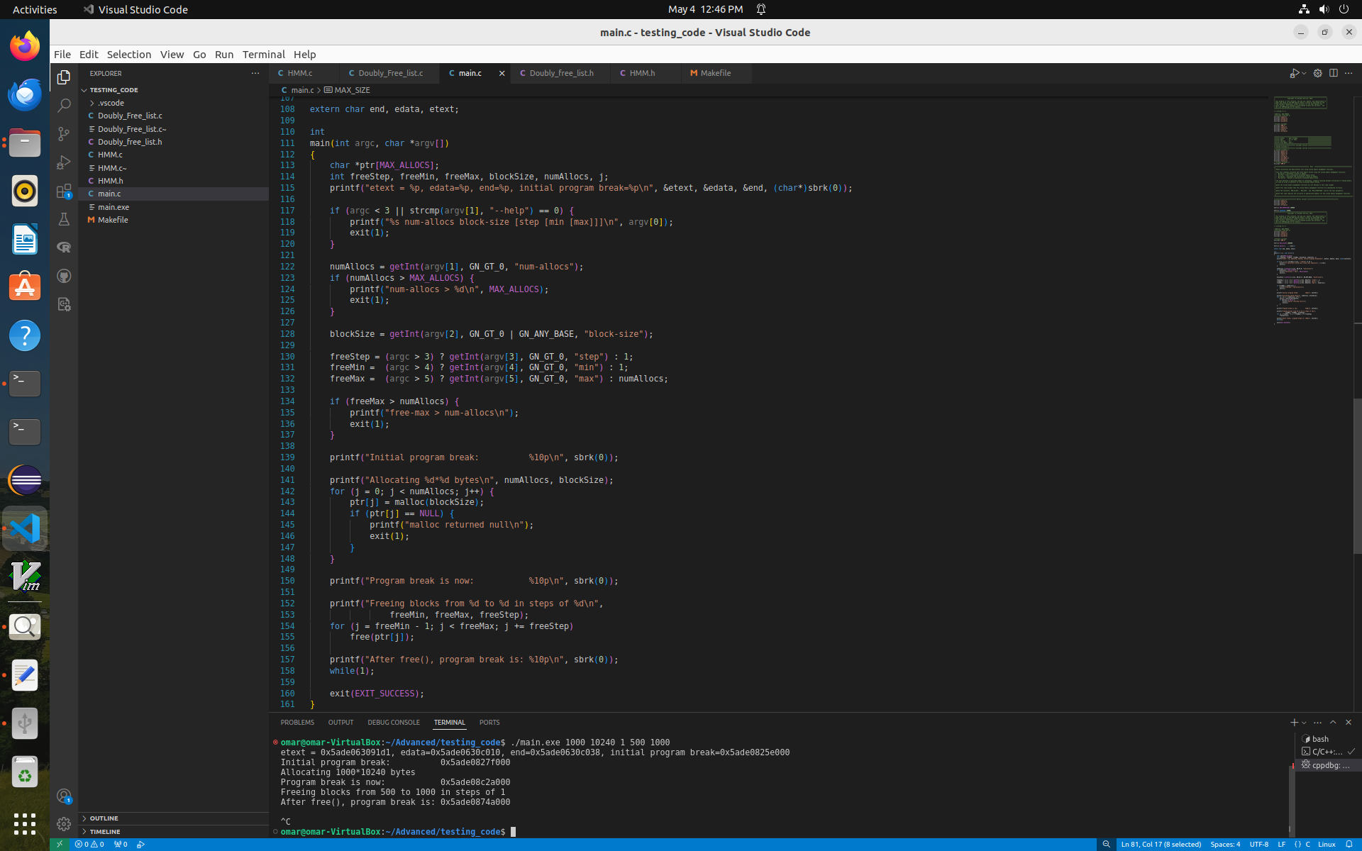
4- Testing
First:
Simple test to verifying allocating and freeing memory
Print current program break to verify that it moves correctly.

Slide 22
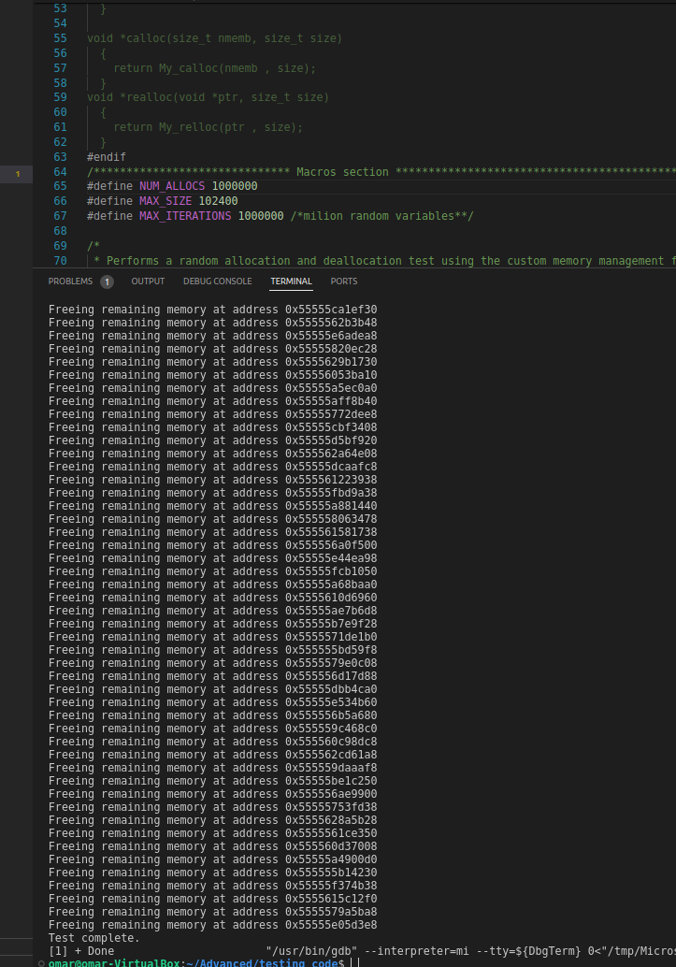
Second:
Strong test to verifying all project (tow function: malloc, free).
This test generate randomized variables of values to of size to allocate and free.
This script do this operation for 1000 000 times of allocating and max size 10000 bytes (can be changed), this test success.

Slide 23
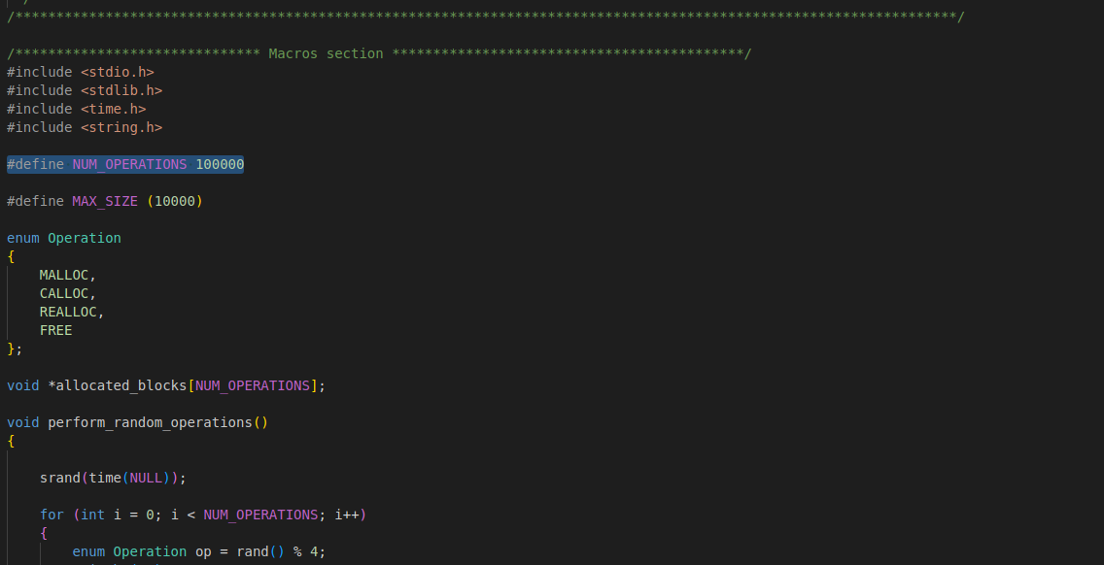
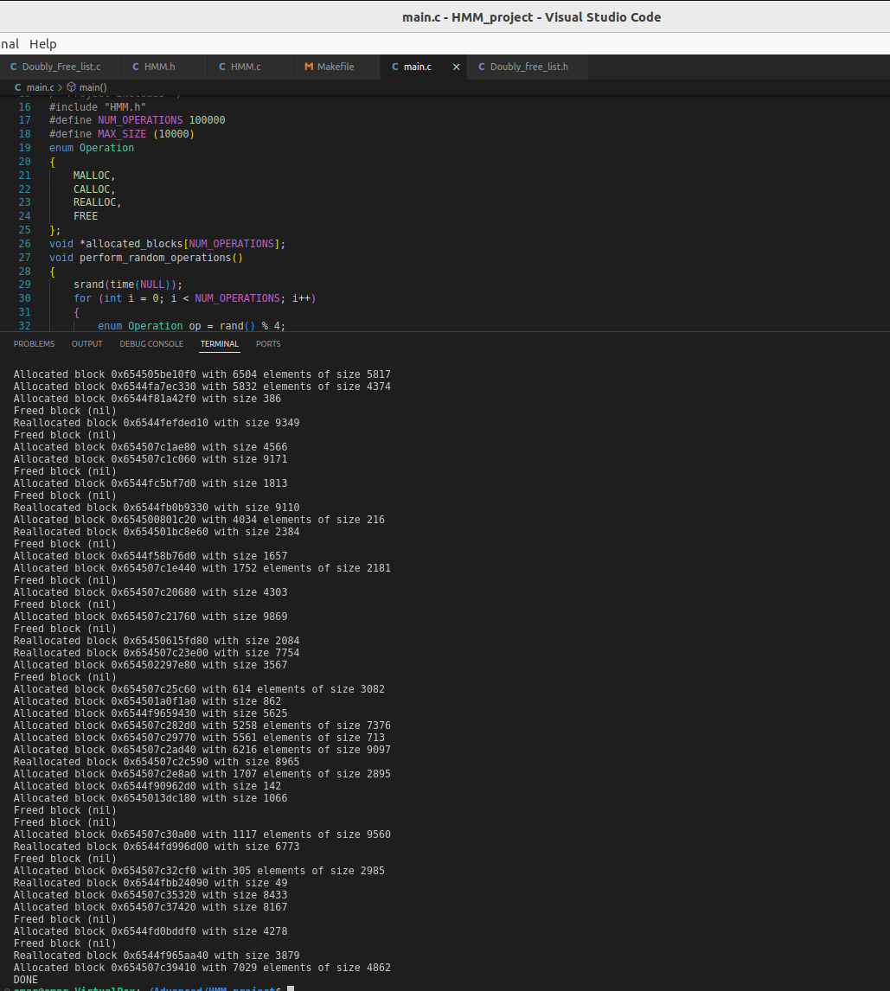
Third:
Test strong to verifying all project (four function: malloc, free, calloc, realloc).
This test generate randomized variables of values to of size to allocate, reallocate and free.
This script do this operation for 100 000 times of allocating and max size 10000 bytes (can be changed), this test success.

Slide 24
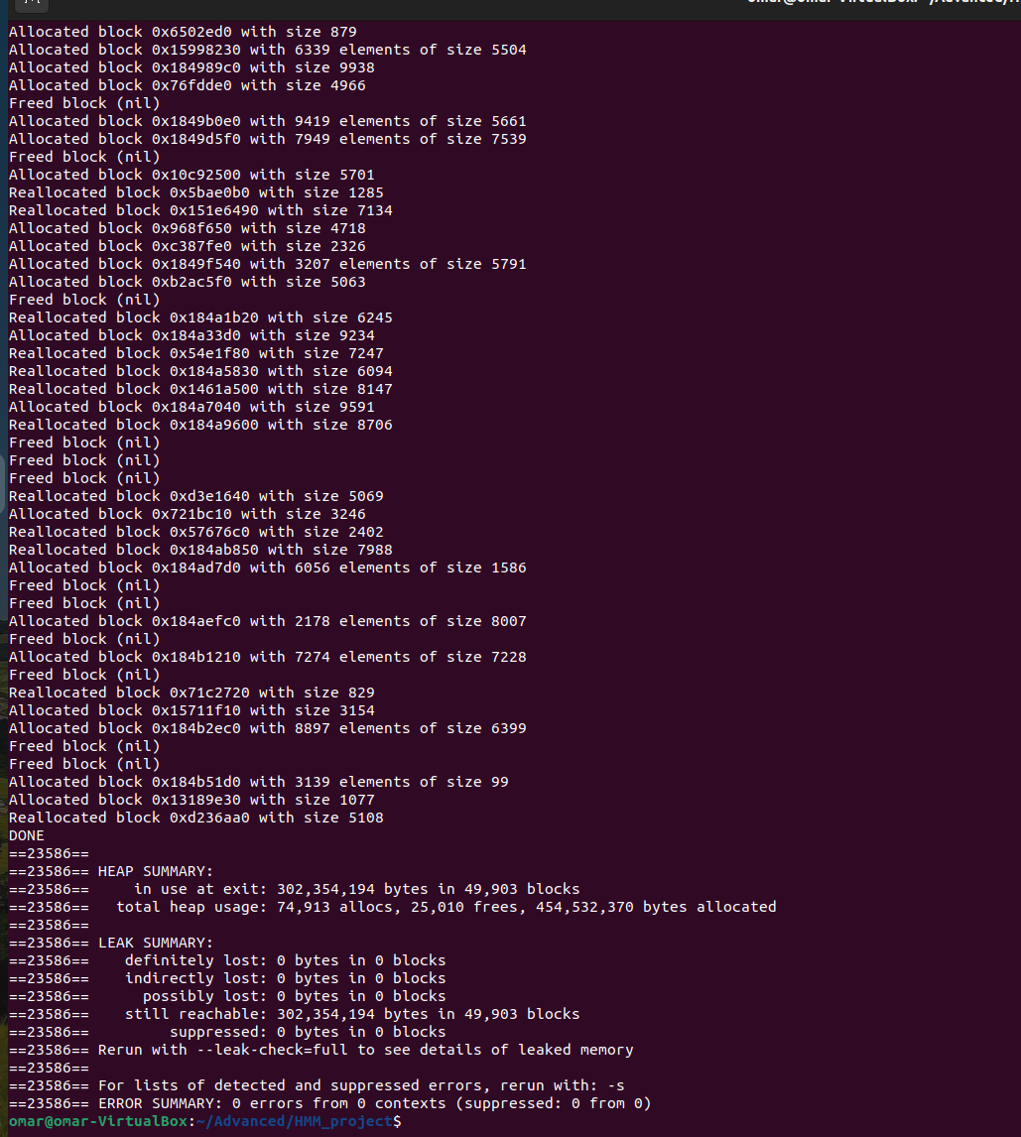
Fourth:
This test to verifying allocating and freeing memory not causes leak of memory by using Valgired program
Print if there are memory leak.

Slide 25
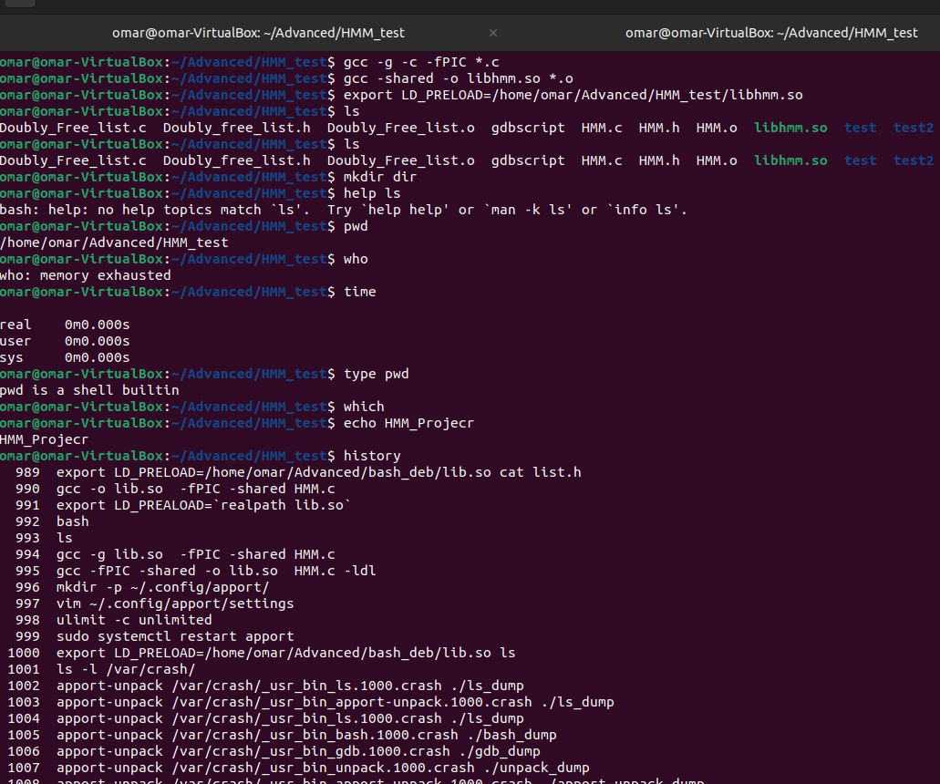
Fifth:
This test is replacing my library with glibc and run some commands based on my library such as: ls, echo.

Slide 26
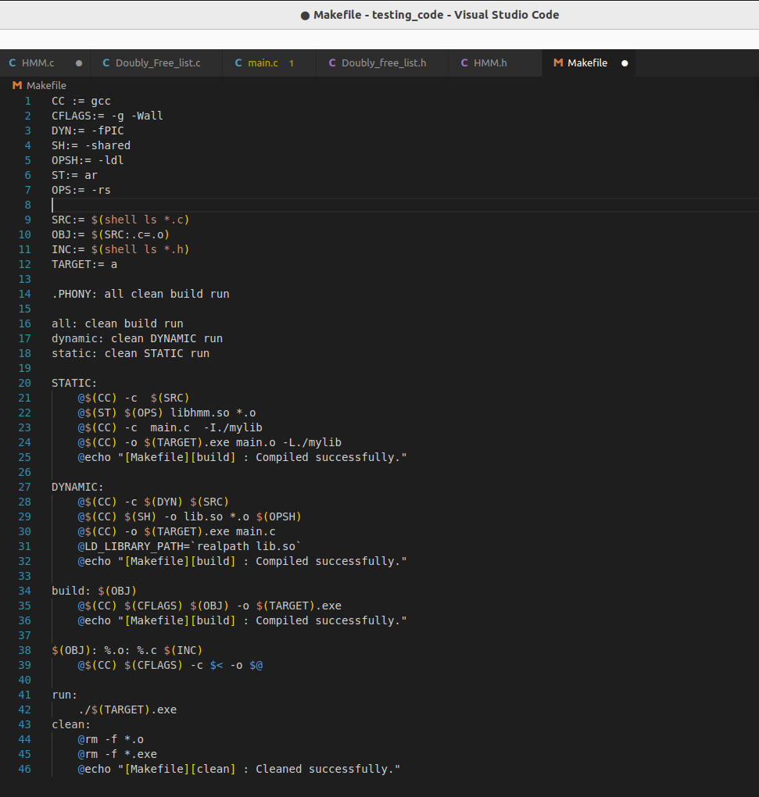



5- Make file
build
Compile this library normally.
Static library
Make my library compiled as .static library using this make file by run: make static .
Program
Shared library
Make my library compiled as .shared library using this make file by run: make dynamic.

Slide 27

THANK YOU
Reference: The Linux Programming Interface
By MICHEL KERRISK
to contact me
Click here

